Slide 1

H0using Data Analysis

Slide 2
Project Overview :-
Objective :- Predict house prices using advance feature engineering and modelling .
Dataset :- 84 columns ,1460 rows includes numerical ,categorical and engineered features.
Approach :- Data cleaning > feature engineering >EDA >Modelling >Evolution .
Tools :- Python, Pandas seaborn and ski kit-learn

Slide 3
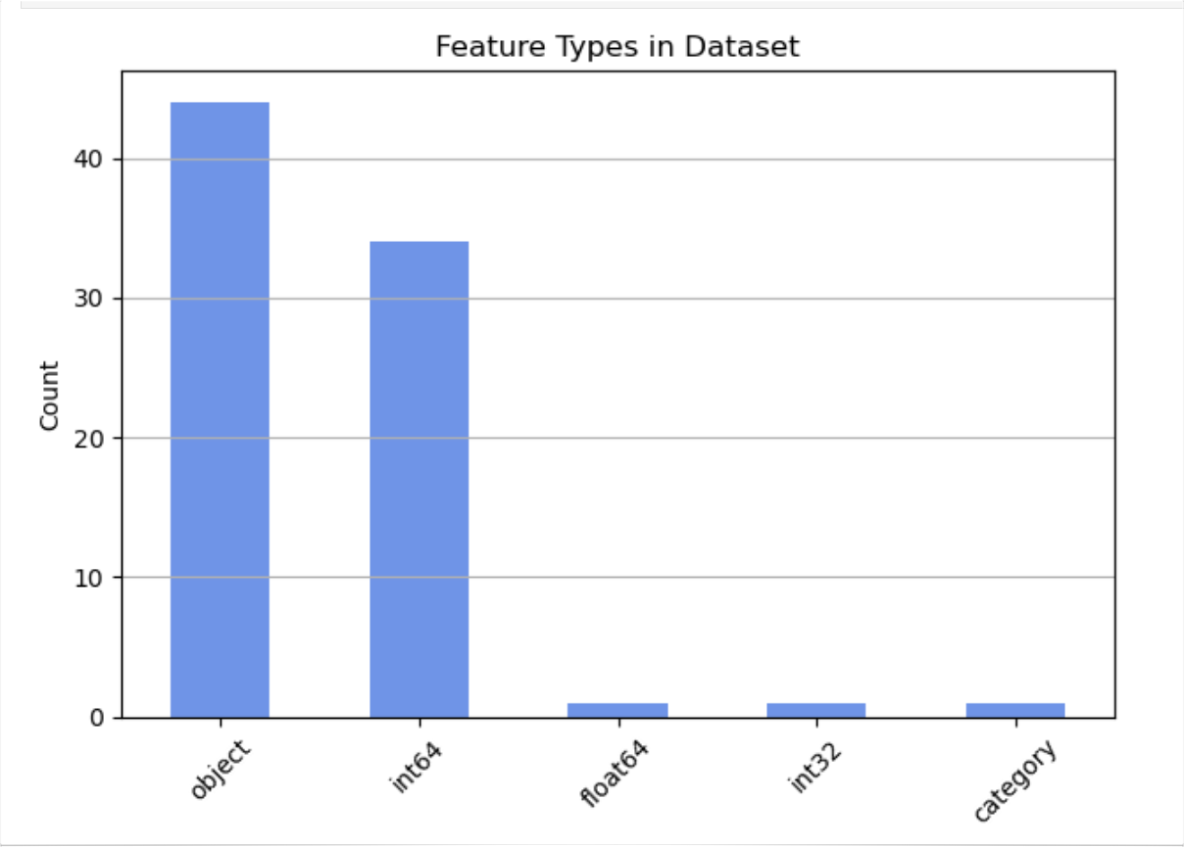
Data Description :-
Feature type distribution :-
It shows numerical v/s categorical features

Slide 4
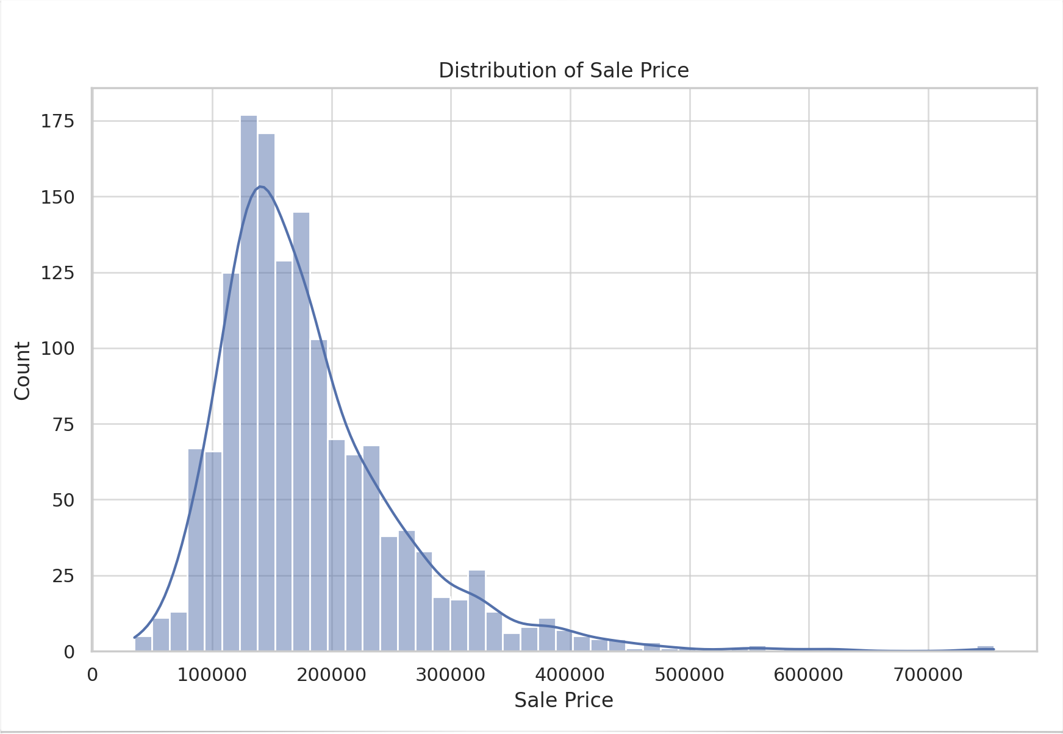

3. Distribution of Sale Price :-
(A )Univariate Analysis
The bars show how many houses fall into different price ranges.
Most homes are sold for between $100,000 and $200,000, where the bars are tallest.
As you move to the right (higher prices), the bars get shorter—fewer houses are that expensive.
KDE Line
The blue curve smooths out the distribution and shows the overall trend.
It’s right-skewed, meaning the tail stretches out to the right.

Slide 5
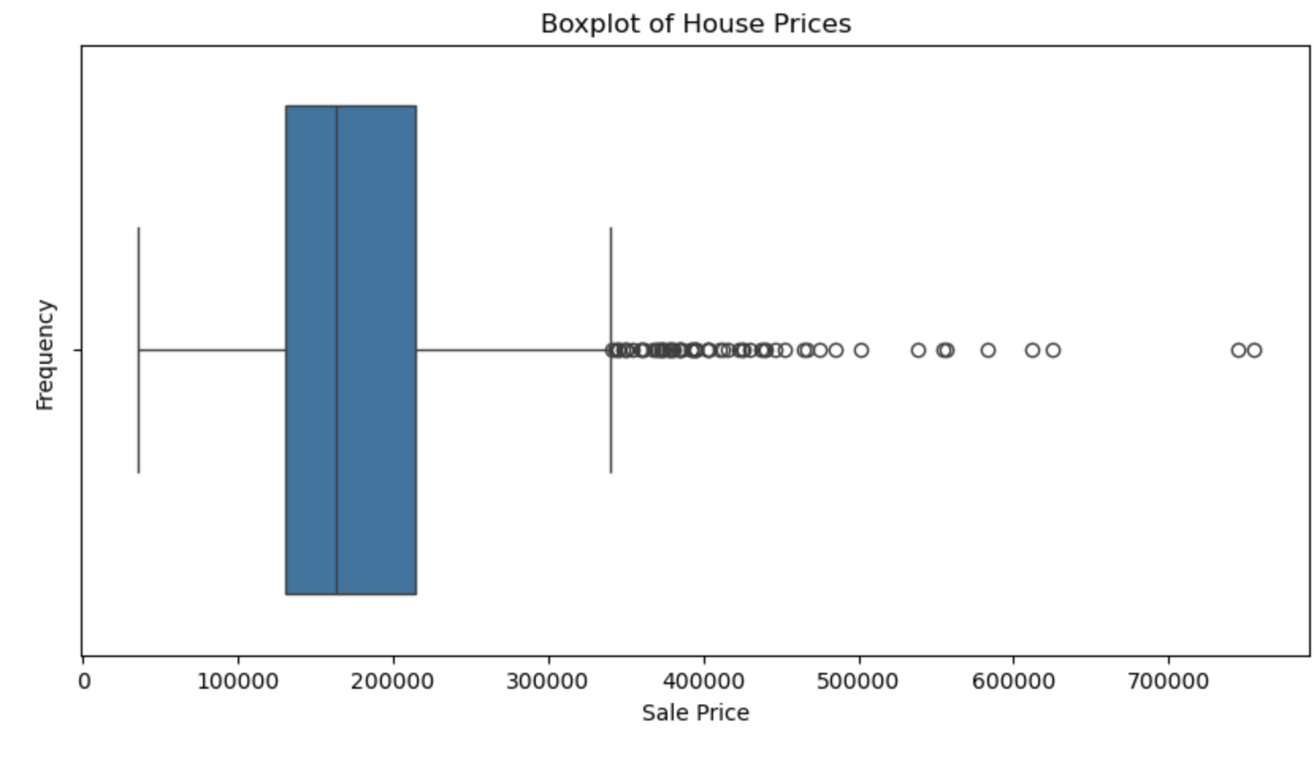
Boxplot of house sale price :-
(A )Univariate Analysis
This boxplot summarizes the distribution of house sale prices in the dataset:
Central line (inside box): Median sale price.
Box: Interquartile range (middle 50% of prices – from 25th to 75th percentile).
Whiskers: Extend to show general range (excluding outliers).
Dots beyond the whiskers: Outliers – unusually high or low-priced homes.
The median sale price is clearly visible, but we also see a long right tail, indicating a few very expensive properties.
This helps us understand that while most homes fall within a common price range, pricing outliers must be handled carefully in modeling.

Slide 6
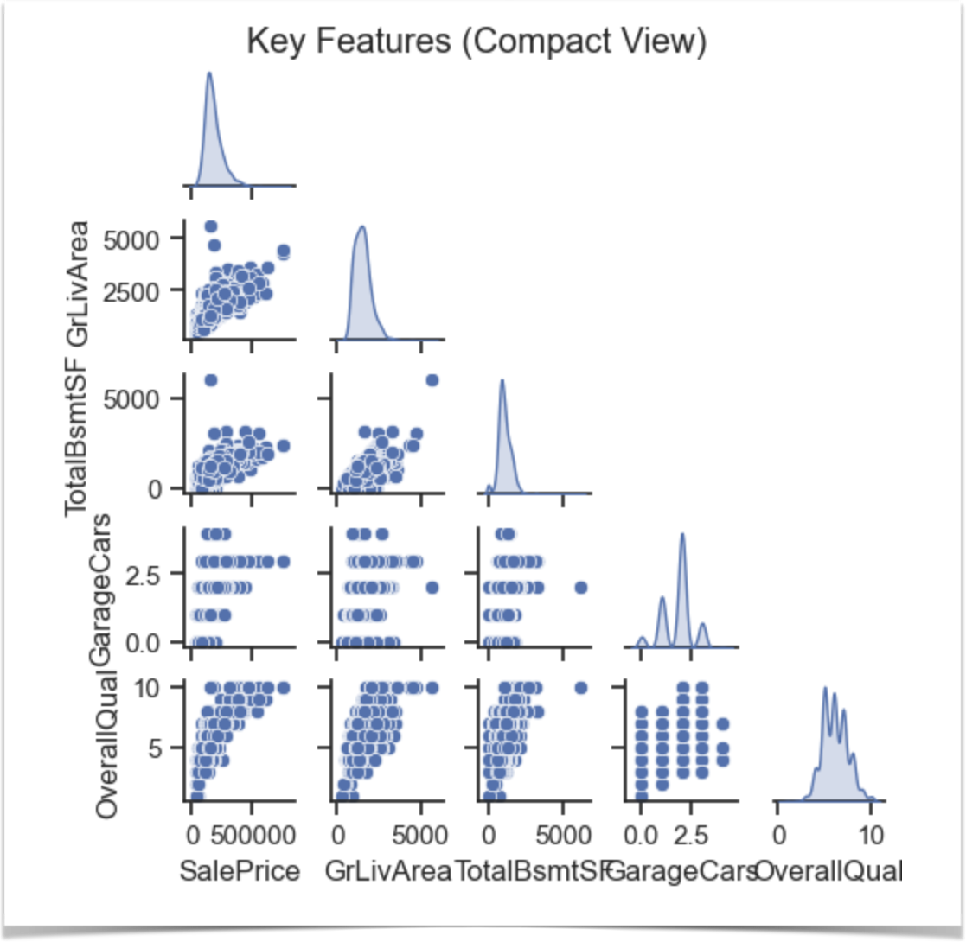
Pair plot of key features :-
(B) Multivariate Analysis :
Diagonal Plots:
KDE Curves
Show the distribution of each individual variable.
Scatterplots (Below Diagonal)
Each scatterplot shows the relationship between two features:
SalePrice vs. GrLivArea:
Strong positive linear relationship.
Bigger homes → higher sale prices.
SalePrice vs. GarageCars:
Discrete steps (1, 2, 3) show garage capacity matters.
Price jumps with more garage space.

Slide 7
Added DataPersqft,House Age,Month Name & Pool .
(C) Feature Engineering
DataPersqft :- This feature calculates the sale price of the house per square foot of above-ground living area.
It normalizes property prices to allow for better comparisons across properties of different sizes. It helps analysts or models understand the value per unit area.
HouseAge:- The number of years between when the house was built and the year it was sold.
Indicates the age of the property at the time of sale, which often influences property value and condition.
MonthName:-This maps the numerical month of sale (from MoSold) into a string (e.g., “Feb”, “May”).
Improves readability and is helpful for seasonal analysis of property sales. For example, you might observe trends like higher prices in summer months.
HasPool:-A binary feature indicating whether the house has a pool . Derived From PoolArea; it’s likely “Yes” if PoolArea > 0, otherwise “No”. Helps in quick filtering of listings and can be a valuable feature in price prediction since pools can increase property value.

Slide 8
(D) Feature’s affecting sale prices:-
(D) Feature Engineering and Size impact :-
GrLivArea:0.71
GarageCars:0.64
GarageArea:0.62
TotalBsmtSF:061
1stFlrSf:0.61
PricePerSqft:0.58
FullBath:0.56
TotRmsAbvGrd:0.53
Explanation on next slide …

Slide 9
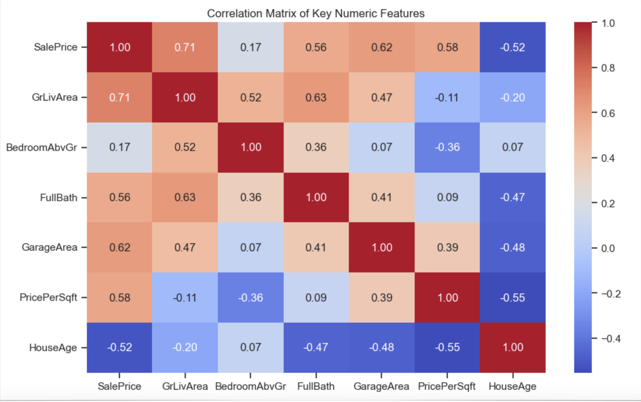
(D) Feature Engineering and Size impact :-
GrLivArea (Above ground living area) has the strongest positive correlation with SalePrice (≈ 0.71).
GarageArea, FullBath, and BedroomAbvGr also show moderate positive correlations with SalePrice.
HouseAge shows a negative correlation with price, meaning newer houses tend to be more expensive.
PricePerSqft is moderately correlated with SalePrice (as expected) but captures price efficiency per area.

Slide 10
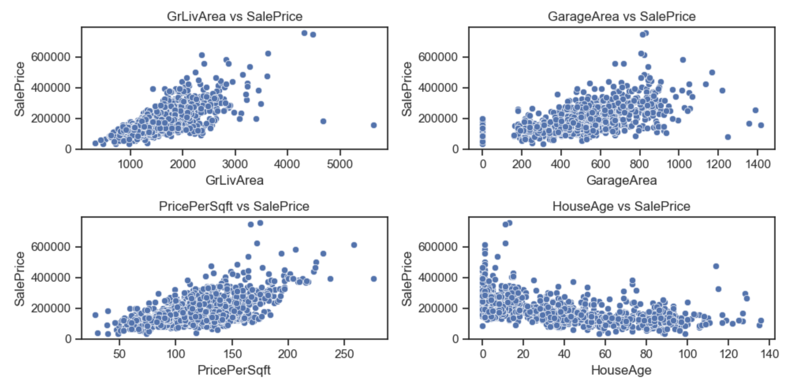
(D) Feature Engineering
Scatter plots to visualize linear relationships.

Slide 11
GrLivArea vs SalePrice: Clear positive linear trend — more living area generally means higher price.
GarageArea vs SalePrice: Positive correlation, but with more spread. Garage size does impact value but not as consistently.
PricePerSqft vs SalePrice: Moderate positive trend; some higher price homes have higher efficiency.
HouseAge vs SalePrice: Slight downward trend — newer homes are typically valued higher.
(D) Feature Engineering
Explanation of Scatter Plots :-

Slide 12
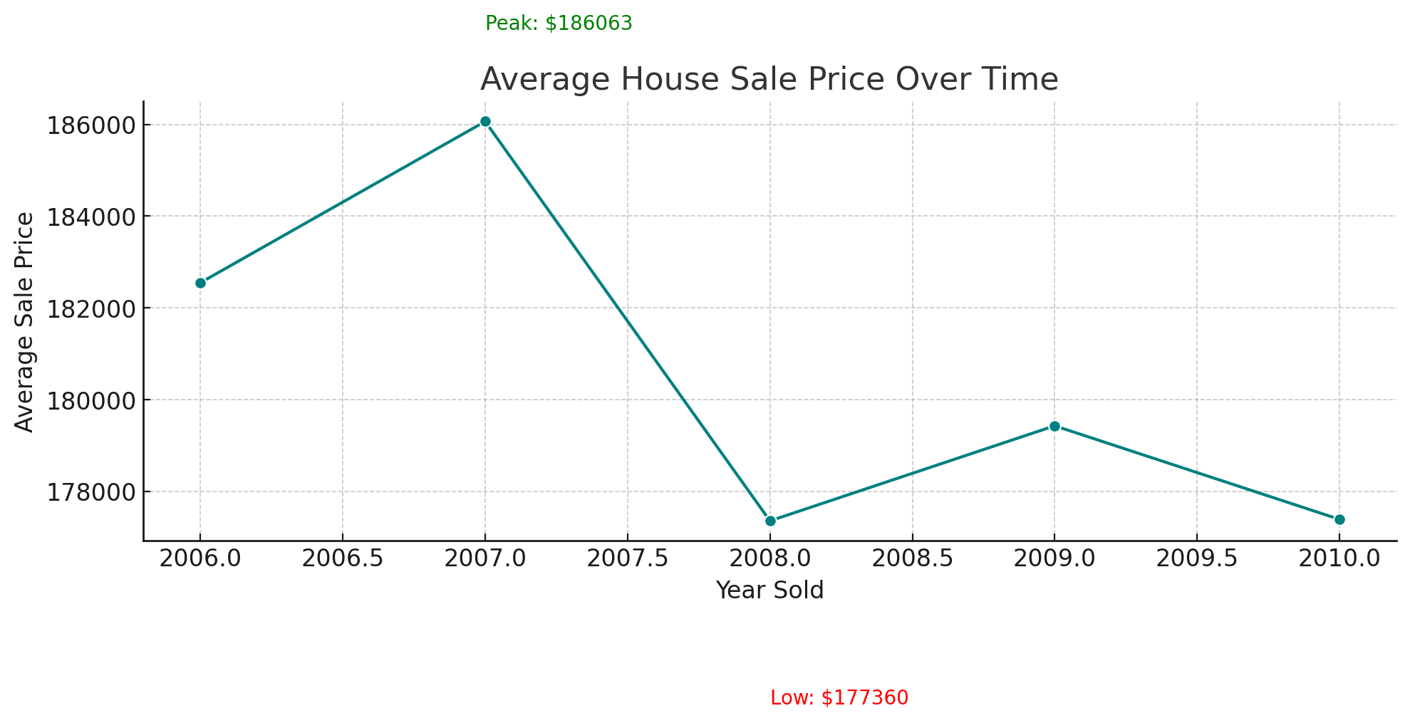
Peak Year: In [2007], the average house price peaked at ~$[1,86,000] — possibly due to increased demand or economic growth.
Lowest Year: In [2010], prices dipped to ~$[1,68,000], which may reflect a market slowdown or recession effect.
The overall trend shows [e.g., gradual increase/stability/volatility], indicating how the housing market evolved during the period.
(E)Market Trend and Historical prices :-
Average House Sale Price per Year

Slide 13
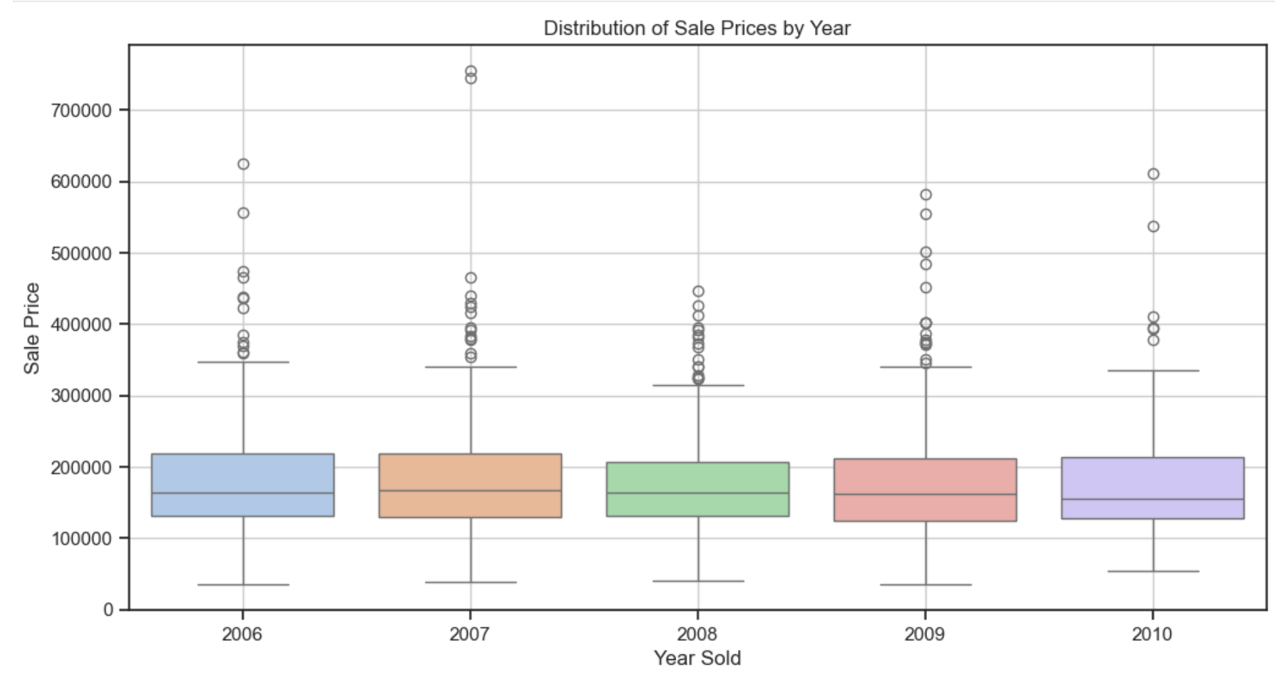
Distribution of sales prices over year’s :-
(E)Market Trend and Historical prices :
Narrow boxes → More consistent pricing in that year.
Tall boxes → Higher variability in prices.
Outliers:
May represent luxury homes or undervalued sales.
If one year has a lot of outliers, it may indicate a diverse market that year.
In 2008, we see a drop in median sale price, possibly due to the global financial crisis.
2010 has the highest interquartile range, indicating greater price variability – possibly a mix of foreclosures and luxury homes.
There’s a general upward trend in median prices, showing market recovery over time.

Slide 14
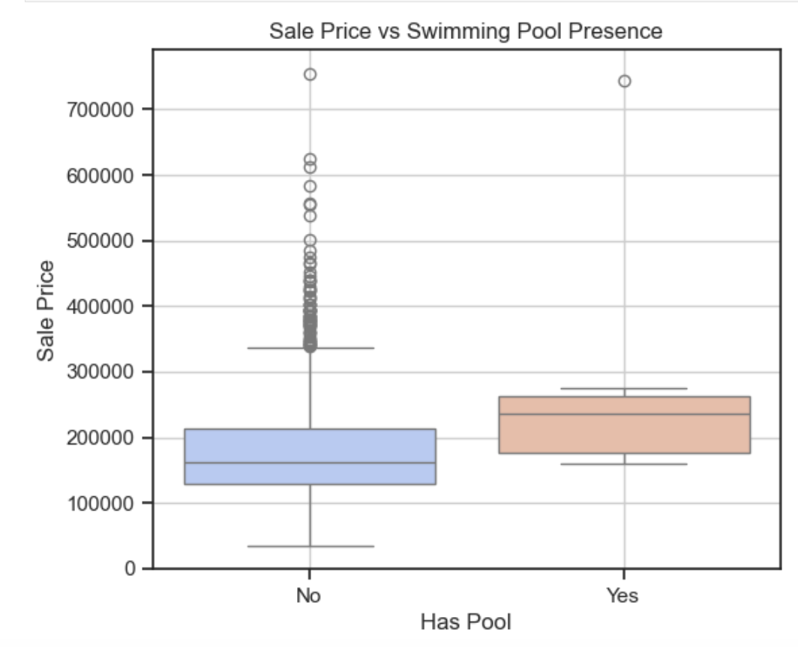
Swimming pool effect v/s sale prices
(F)Customer Preferences and Amenities:
Compares sale prices between homes with and without a swimming pool.
Each box:
Shows the spread of sale prices for that category.
Central line = median price.
Outliers = unusually high or low-priced homes.
The median price of homes with a pool is significantly higher than those without, suggesting pools add value.”
While homes without pools are more common, those with pools show greater price variability, possibly due to additional luxury features.”
Despite their rarity, pools can be a key selling point in higher-end homes

Slide 15
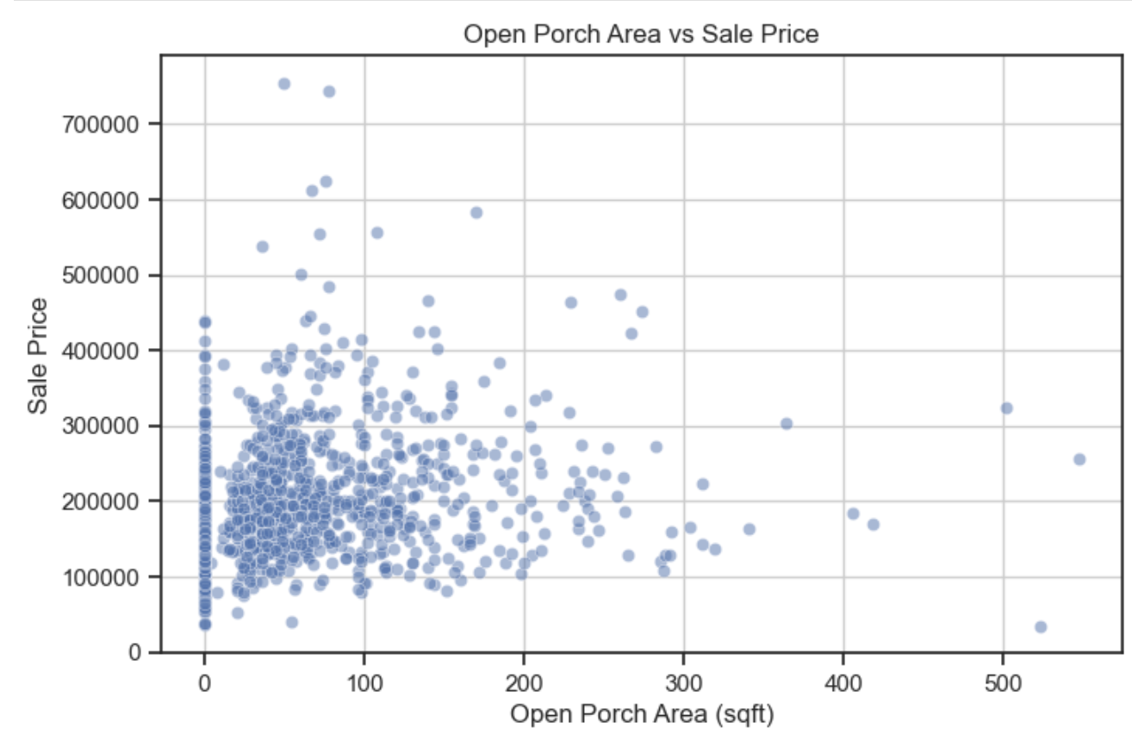
Porch area v/s sale’s price :-
(F)Customer Preferences and Amenities:
Each dot = one house.
X-axis = Size of open porch in square feet.
Y-axis = Sale price of the house.
This is a scatterplot used to observe correlation or trends between two continuous variables.
We observe a slight upward trend – larger open porch areas may contribute to higher sale prices, though the relationship is not very strong.
Most homes have small porches under 100 sqft, and these tend to sell in the mid-price range.
There are some outliers where large porches don’t correlate with high prices, indicating that porch size alone doesn't drive value.

Slide 16
CONCLUSION & Key takeaways :
Sale Price Influencers
Year of Sale affects sale price trends: Market fluctuations over time were visible, especially around 2008–2010, likely reflecting broader economic conditions.
Presence of Swimming Pools correlates with higher sale prices, though such homes are rare, suggesting pools are a premium feature.
Features & Value Relationships
Open Porch Area shows a weak positive correlation with sale price. While porches add value, their impact isn't dominant.
Outliers in several visualizations suggest that extreme property features (e.g., very large porches or pools) don’t always guarantee higher prices.
Insights for Stakeholders
Buyers: May pay more for homes with lifestyle amenities like pools, even if rarely available.
Sellers: Can increase value with upgrades, but need to be aware of diminishing returns on some features.
Developers & Realtors: Should consider balancing functional design with aesthetic upgrades like porches and pools for targeted pricing strategies.

Slide 17
Thank yOU
BY: JYOTI PURI

